Slide 1





01/13
https://github.com/danialsfy
INTRODUCTION TO
PASSWORD
CRACKING
by
Danial Wajdi

Slide 2
CONTENTS
02/13
Introduction
Understanding Hashes
Attacker’s Perspective
Password Cracking
Defense and Mitigation

Slide 3

INTRODUCTION
03/13
A password is a string of characters used to verify a user's identity and grant access to systems, applications, or data.
A combination of letters, numbers, and symbols in a string for identity validation
Linux - /etc/shadow
Windows - C:\Windows\System32\config
Apply salt to prevent rainbow table attack

Slide 4
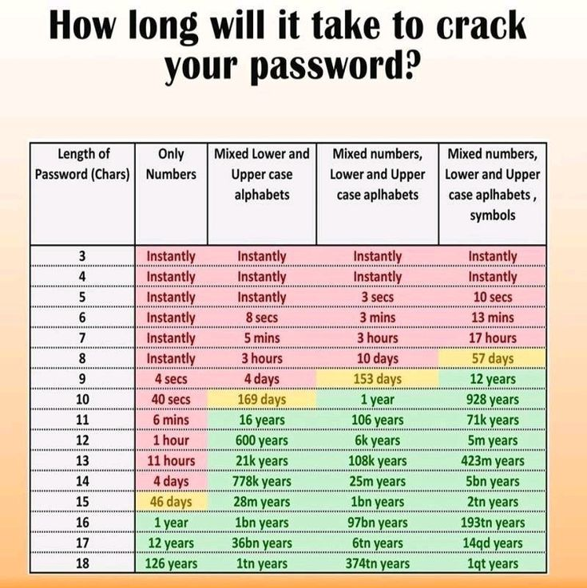
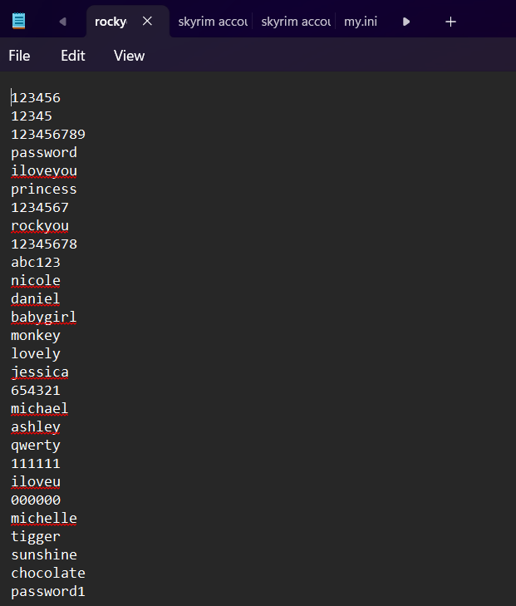
INTRODUCTION
04/13
Time taken if use brute-force attack
Dictionary attack

Slide 5

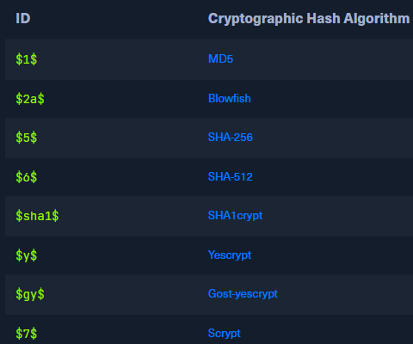

UNDERSTANDING THE HASHES
05/13
/etc/shadow file format in kali linux

Slide 6
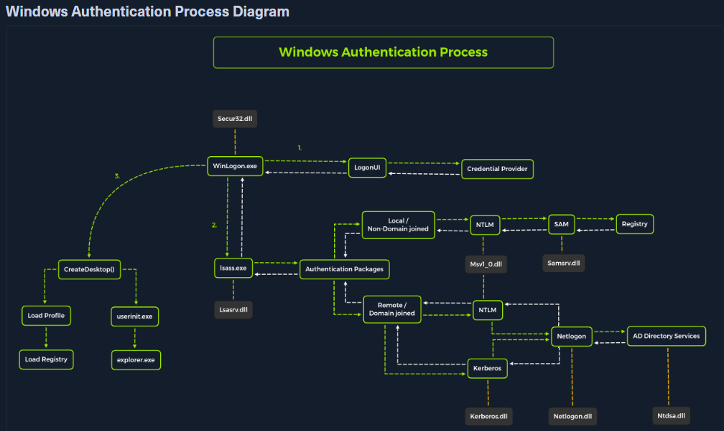
INTRODUCTION
02/15
06/13

Slide 7



07/13
ATTACKER
PERSPECTIVE
On Linux, hashes are stored in /etc/shadow, accessible with root privileges.
On Windows, password hashes are stored in the SAM file and can be extracted using tools like Mimikatz, secretsdump.py, or pwdump.
On websites or apps, SQL injection or other vulnerabilities may reveal password hashes from databases.
In breach scenarios, hackers may find publicly leaked password files or breach dumps.

Slide 8

08/13
Process of converting a password hash back into the original plaintext password
PASSWORD
Offline : using stolen hash
CRACKING
Online : repeatedly attempting logins
Brute force, dictionary, rule-based

Slide 9



09/13
CRACKING
TOOLS
John the Ripper
Hashcat
John is a fast, flexible, and easy-to-use password cracker. It works best for offline cracking and supports many hash types.
Hashcat is a powerful, GPU-accelerated password cracker known for its speed and flexibility. It supports over 300 hash types.
Hydra
Hydra is used for online brute force attacks on protocols like SSH, HTTP, FTP, and RDP.

Slide 10
JOHN THE RIPPER
10/13
Create a file
echo 'testuser:$6$abcdefgh$UeD1G1ECcB3Tqxg0gZB4YcqumMGAFQcIly5CE3Z3VQ.tY5aek0PObiZTzUwJppYsvKxvO2R3REKYVblUO1u9C/:19191:0:99999:7:::' > shadow_hashes.txt
Unshadow the file
unshadow /etc/passwd shadow_hashes.txt > crackme.txt
Run John
john --wordlist=/usr/share/wordlists/rockyou.txt crackme.txt
Show cracked password
Expected Output
john --show crackme.txt
testuser:password123

Slide 11
HASHCAT
11/13
Create a user
sudo adduser testuser
# Set password to 123456
Run Hydra
hydra -l testuser -P /usr/share/wordlists/rockyou.txt ssh://127.0.0.1
Expected Output
[22][ssh] host: 127.0.0.1 login: testuser password: 123456

Slide 12
HYDRA
12/13
Create a hash file
5f4dcc3b5aa765d61d8327deb882cf99
Basic Dictionary Attack
hashcat -m 0 -a 0 hash.txt /usr/share/wordlists/rockyou.txt
Dsiplay Cracked Hash
hashcat -m 0 -a 0 hash.txt /usr/share/wordlists/rockyou.txt --show
Expected output
5f4dcc3b5aa765d61d8327deb882cf99:password

Slide 13



13/13
Strong Password
Use long, random, and unique passwords.
DEFENSE
Multi-factor Authentication
MITIGATIONS
Adds a second layer (like SMS or app token) that passwords alone cannot bypass.
Rate Limiting
Protect online services from brute force attempts.

Slide 14
THANK
YOU!

